Slide 1

Network Analysis in R
Kayla Blincow
R Users
5/20/2020

Slide 2
What is Network Analysis?
Emerged as way to better understand complex systems made up of interdependent components
Social Networks
Transportation Networks
Neural Networks
Trade Networks
Basically network analysis is a tool that can be used to understand how different players in networks interact

Slide 3

What I use Network Analysis for…
Understanding interactions among species in multispecies fisheries
Understanding what drives trade of fisheries products globally

Slide 4
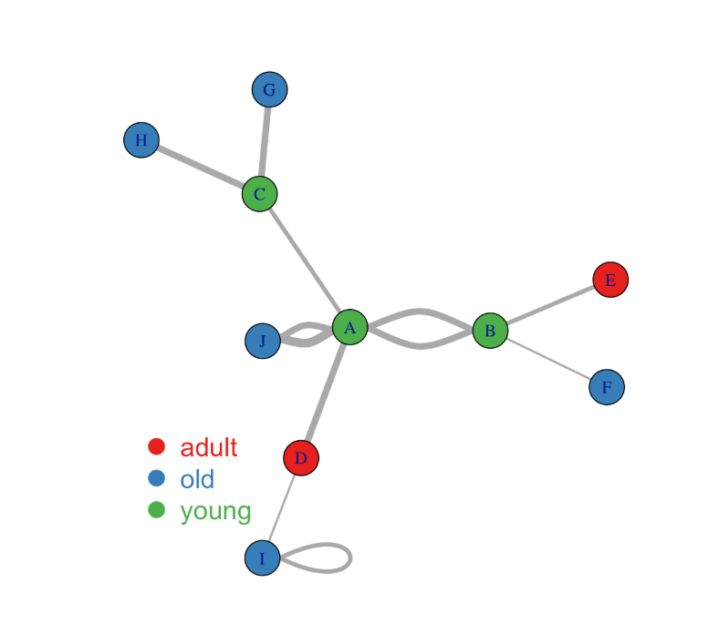
Network Analysis Basics
Components: Nodes and Edges
Directed vs. Undirected
Weighted vs. Unweighted
Metrics
Degree: how many edges are connected to a node
Density: # of edges/# of possible edges
Centrality: importance of a node to the network
Lots and lots of options for calculating this…
Lots of other things I won’t go into here
Group identification, path analysis, etc.

Slide 5
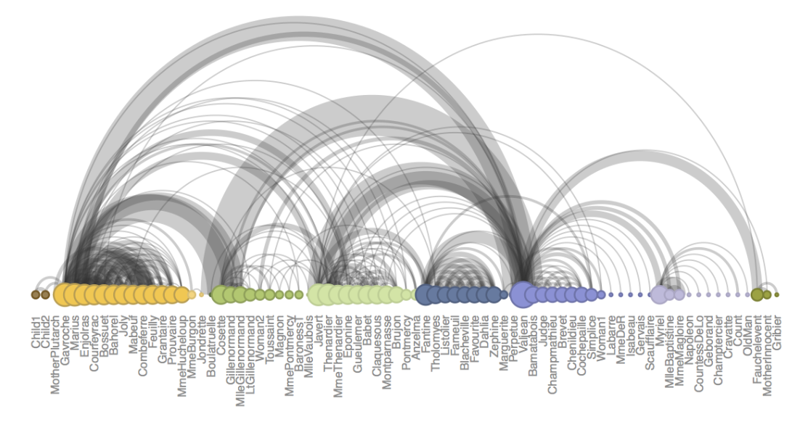
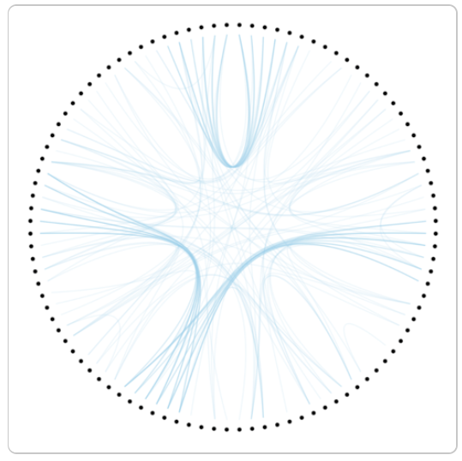
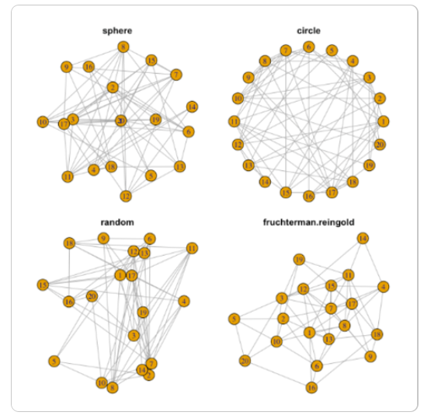
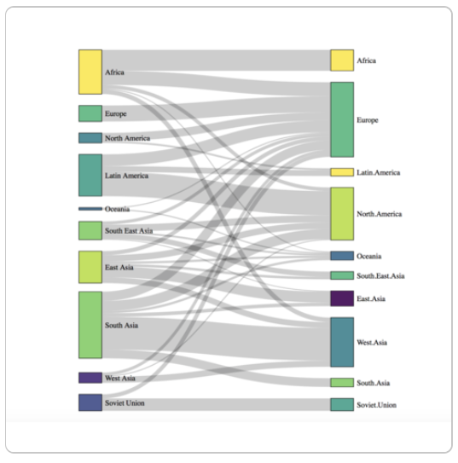
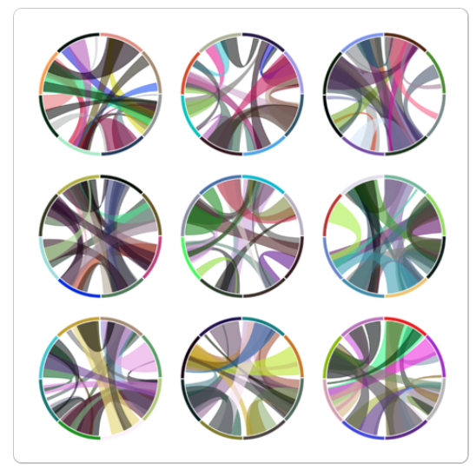
Network Visualization
R-graph-gallery.com

Slide 6
Network Visualization
R-graph-gallery.com

Slide 7
Switch to code…

Slide 8
Helpful Resources
https://github.com/briatte/awesome-network-analysis
So many links…
http://networksciencebook.com/
Albert-Laszlo Barabasi
https://scottbot.net/lets-talk-about-networks/
Really good/simple walk through of basics of networks

